Slide 1
Multi-Speaker Identification
Chris J., Hubert L., Huda I.

Slide 2
Signal Processing and Communications
What is it?
Applications
“ a branch of electrical engineering that models and analyzes data representations of physical events” [1]
Data Sciences
Wearables
Speech/ Voice Recognition
Approaches
Digital Signal Processing (DSP)
Machine Learning
Notes:
Answer what is topic
Why is it important
Give example of applications
Use “approaches” section to segway into next slide

Slide 3
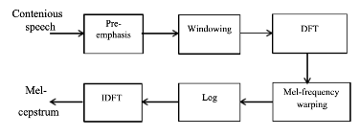
Digital Signal Processing
Cepstral Analysis
Use Fourier Transform of inputted signal
Take log of the spectrum
Notes:
cepstral analysis, which “involves the decomposition of speech signal frames into coefﬁcients in the log spectral domain through the modeling of the human ear performance with the Mel ﬁlter bank.
Cepstrum analysis is a nonlinear signal processing technique with a variety of applications in areas such as speech and image processing.
The complex cepstrum of a sequence x is calculated by finding the complex natural logarithm of the Fourier transform of x, then the inverse Fourier transform of the resulting sequence:
Fourier transform is taken of the framed and windowed inputted speech signal
The logarithm is then taken of the spectrum from the Fourier transform.
Deep neural networks (DNN) is a “neural network regression model trained to reconstruct data from a clean target channel given the same data from a different possibly noisy or reverberant channel or from the same channel as the target.”^{[1]}

Slide 4
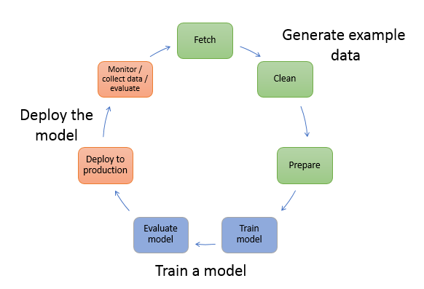
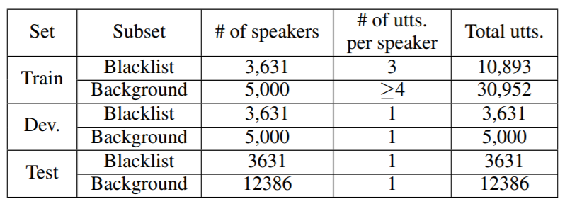
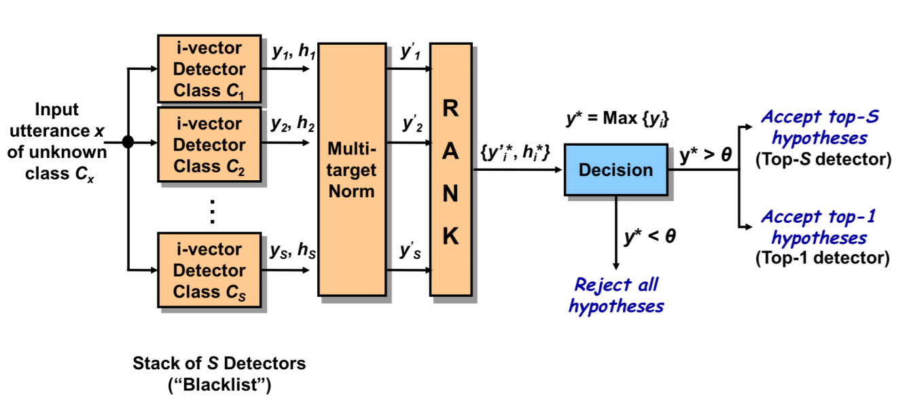
Machine Learning
Existing Work
MCE2018 [2]
Pros:
Showcased many approaches
Compared performance against benchmark
Cons:
Fixed conditions
Limited dataset

Slide 5
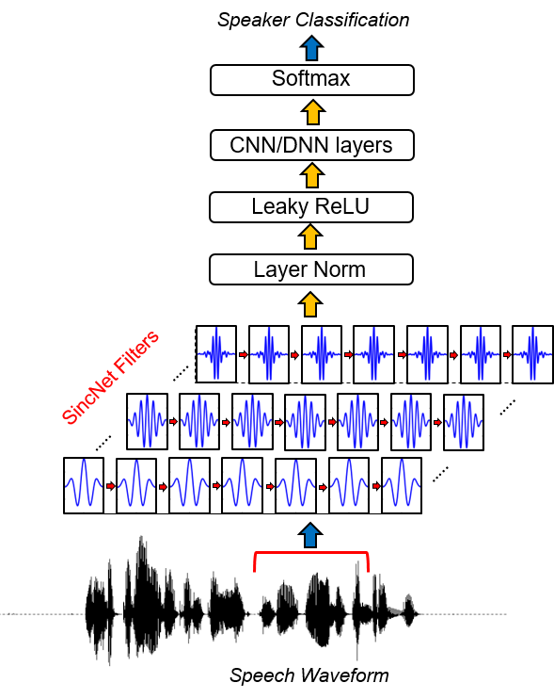
Digital Signal Processing
&
Machine Learning
Existing Work
SincNet [3]
Pros:
Variability in the way it can select filter edges
System was tested using short sentences
Open source
Cons:
Runs only on Linux
[3]
Notes:
Uses cnn to determine the start and stop frequencies of the filter (this is efficient results in efficiency)
Then further processes will cnn the filtered signal
Segway into next slide by saying how AI assistants currently already do both, dsp and cnn, to obtain their results

Slide 6
Existing User Story
As a smart device owner, I want to interact with the system through voice and receive personalized feedback based on my query.

Slide 7
Possible User Story
As a person who participates in a lot of community events, I want my device to be able to recognize and amplify my voice in a crowded stadium when capturing video

Slide 8
Thank you!
References:
[1]“Signal Processing 101,” IEEE Signal Processing Society, Dec. 17, 2015. https://signalprocessingsociety.org/our-story/signal-processing-101 (accessed Sep. 12, 2020).
[2] S. Shon, N. Dehak, D. Reynolds, and J. Glass, “MCE 2018: The 1st Multi-target Speaker Detection and Identification Challenge Evaluation,” INTERSPEECH 2019, pp. 356–360, Sep. 2019.
[3] M. Ravanelli, mravanelli/SincNet. https://github.com/mravanelli/SincNet (accessed Sep. 20, 2020)
https://www.researchgate.net/publication/327719810_Speaker_identification_based_on_normalized_pitch_frequency_and_Mel_Frequency_Cepstral_Coefficients
https://machinelearning.apple.com/research/hey-siri

